Slide 1

Unleashing the Potential of Artificial Intelligence in Translation: From General Applications to Purpose-built Innovations
Sai-cheong SIU
Associate Professor
Programme Director, Master of Arts in Translation (Computer (-Aided) Translation)
The Hang Seng University of Hong Kong

Slide 2




AI is everywhere
Detection and recognition
Analysis and prediction
Robot control
Generation: Text, image and more

Slide 3
AI for Translation
AI-driven applications for General Translation
AI-driven applications for Specialized Translation

Slide 4
Outline
Part 1: An Overview of AI
Part 2: AI for General Translation
Examples
Strengths and Limitations
Recommendations
Part 3: AI for Specialized Translation
Translation of Financial Documents
Translation of Government Documents
Translation of Buddhist Texts

Slide 5
1. An Overview of AI

Slide 6
Features
Uses deep neural networks extensively
Reduces need for hand-crafted rules and feature engineering
Requires big data, powerful hardware, advanced algorithms

Slide 7
2. AI for General Translation

Slide 8
Conventional approaches
Rule-based Machine Translation
Example-based Machine Translation
Statistical Machine Translation

Slide 9
AI-driven tools applicable to translation: Examples
Neural machine translation
Large language models (e.g., ChatGPT)

Slide 10
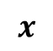
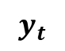
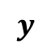


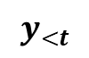
Neural Machine Translation
$$x$$
$$θ$$
ST
Encoder
Internal representation (ST)
$$y_{<t}$$
$$φ$$
$$y_{t}$$
TT so far
Decoder
Internal representation (TT)
Next TT token
$$y$$
TT

Slide 11
Decoder-based Large Language Models like ChatGPT
Prompt + Input
Decoder
Internal representation (TT)
Next token
Output

Slide 12
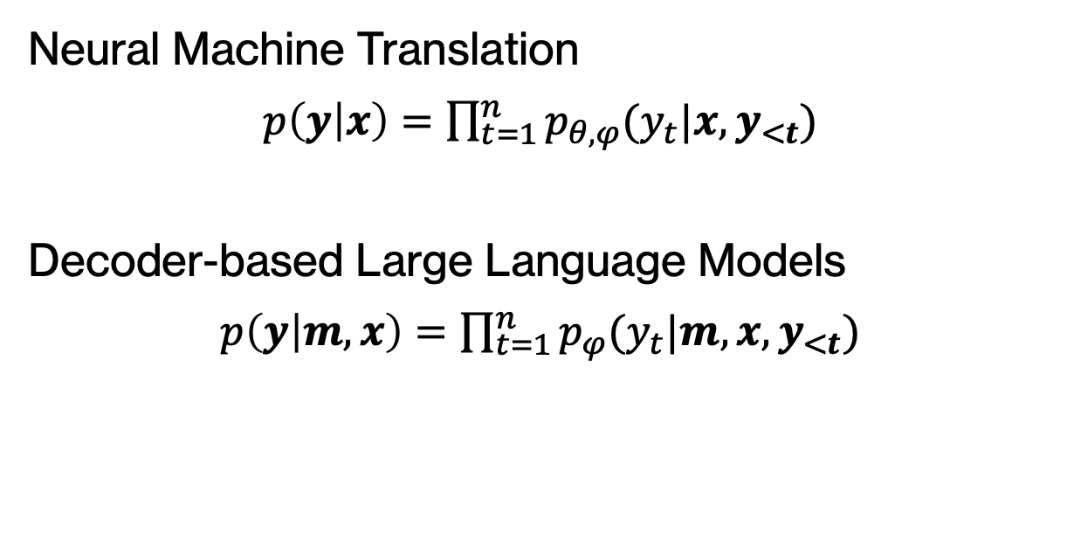
Formally, we have
Neural Machine Translation
$p\left(y | x\right)=$ $\prod_{t=1}^{n}{p_{θ,φ}(y_{t}|x,y_{<t})}$
Decoder-based Large Language Models
$p\left(y | m,x\right)=$ $\prod_{t=1}^{n}{p_{φ}(y_{t}|m,{x,y}_{<t})}$

Slide 13
ChatGPT: An Example
$p\left(y | m,x\right)=$ $\prod_{t=1}^{n}{p_{φ}(y_{t}|m,{x,y}_{<t})}$
2018
GPT-1 (117 million)
2019
GPT-2 (1.5 billion)
2020
GPT-3 (175 billion)
2022
GPT-3.5 (ChatGPT)
2023
GPT-4 (Unknown)

Slide 14
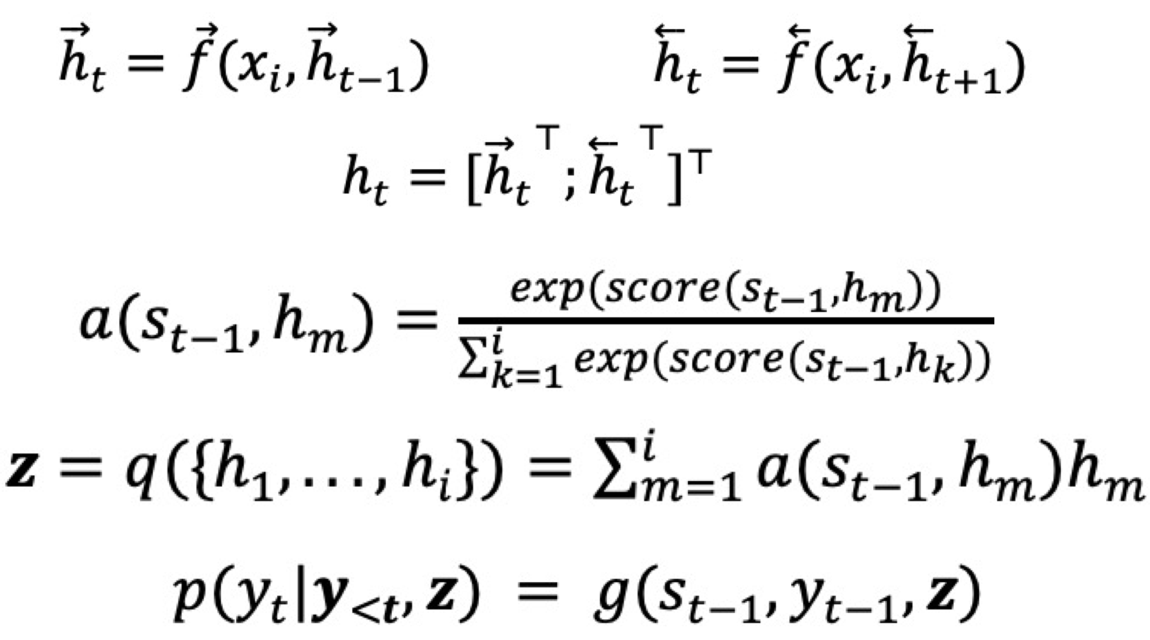
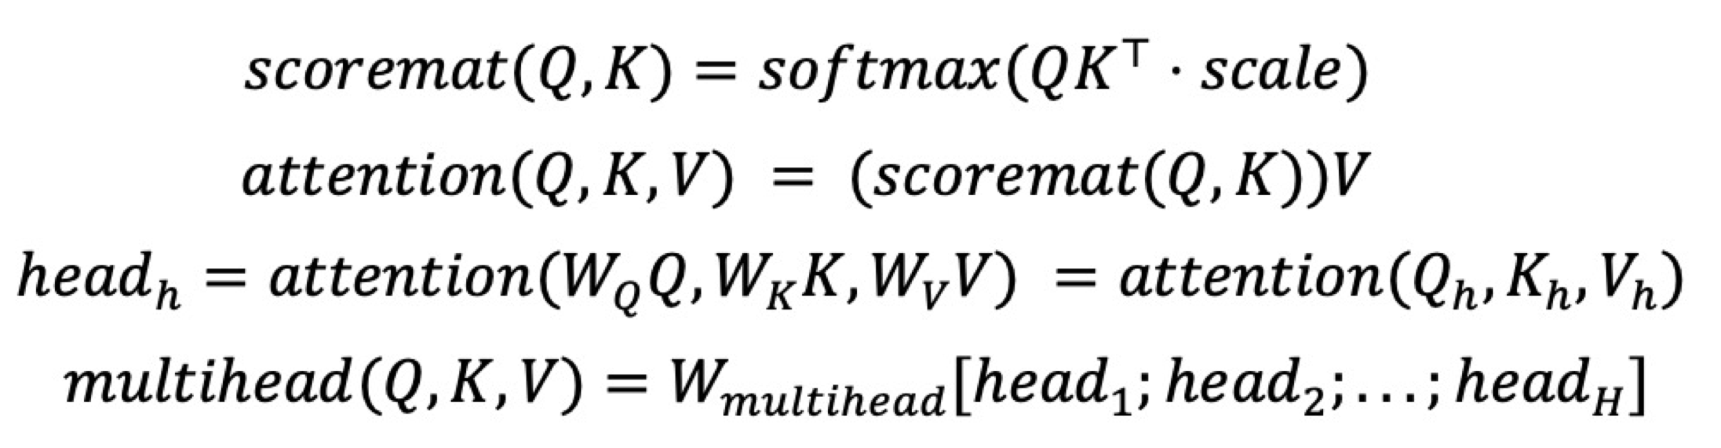
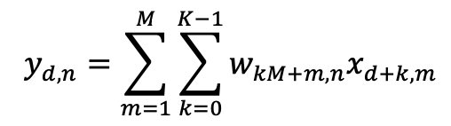
Common architectures
Read more: Siu (2023b)
1. Recurrent Neural Networks (RNN)
2. Convolutional Neural Networks (CNN)
3. Self-attention Neural Networks (e.g., Transformer)
Bidirectional RNN with Attention
One-dimensional convolutional layer
Multi-head Attention with Queries, Keys and Values
Example:
Example:
Example:

Slide 15
Strengths
Higher BLEU scores
Enhanced contextual awareness: dynamic word representations
Integrated support: ST explanation, TT suggestions, quality assessment, and interactive editing (see Siu 2023a)

Slide 16
Limitations
Difficulty with long sentences
Limited effectiveness in specialized domains
Inadequate support for non-English languages
Insufficient background knowledge and in-depth contextual analysis
Potential for errors such as hallucination and outdated information.

Slide 17
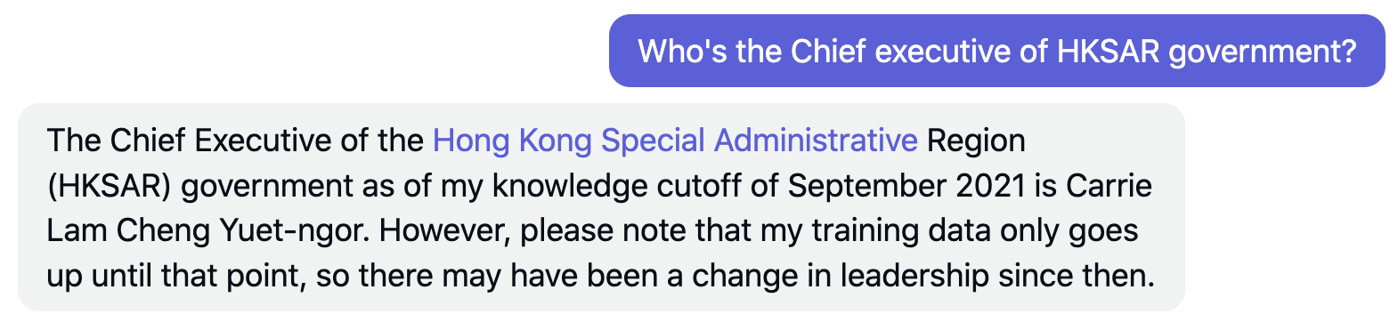
ChatGPT: Limited knowledge after 2021

Slide 18
Hallucination: An Interesting Example
See Siu (2023a)
Translate the following into English: 行政長官李家超今日（三月十五日）繼續在北京的訪問行程。他先後拜訪國家科學技術部、文化和旅遊部、海關總署和商務部，與各部門領導就共同關注的事宜交換意見。文化體育及旅遊局局長楊潤雄、政制及內地事務局局長曾國衞、保安局局長鄧炳強、商務及經濟發展局局長丘應樺、醫務衞生局局長盧寵茂教授和創新科技及工業局局長孫東教授亦有出席相關會面。

Slide 19
ChatGPT’s translation
On March 15th, the Chief Executive, Mr. Carrie Lam, continued her visit to Beijing. She visited the Ministry of Science and Technology, the Ministry of Culture and Tourism, the General Administration of Customs, and the Ministry of Commerce, and exchanged views with leaders of these departments on matters of common concern. The Director of the Tourism Bureau, Mr. Yang Runxiong, the Director of the Constitutional and Mainland Affairs Bureau, Mr. Patrick Nip, the Director of the Security Bureau, Mr. John Lee Ka-chiu, the Director of the Commerce and Economic Development Bureau, Mr. Edward Yau Tang-wah, the Director of Health, Professor Sophia Chan Siu-chee, and the Director of the Innovation and Technology Bureau, Professor Alfred Sit Wing-hang, also attended the relevant meetings.

Slide 20
ChatGPT’s translation
On March 15th, the Chief Executive, Mr. Carrie Lam, continued her visit to Beijing. She visited the Ministry of Science and Technology, the Ministry of Culture and Tourism, the General Administration of Customs, and the Ministry of Commerce, and exchanged views with leaders of these departments on matters of common concern. The Director of the Tourism Bureau, Mr. Yang Runxiong, the Director of the Constitutional and Mainland Affairs Bureau, Mr. Patrick Nip, the Director of the Security Bureau, Mr. John Lee Ka-chiu, the Director of the Commerce and Economic Development Bureau, Mr. Edward Yau Tang-wah, the Director of Health, Professor Sophia Chan Siu-chee, and the Director of the Innovation and Technology Bureau, Professor Alfred Sit Wing-hang, also attended the relevant meetings.

Slide 21
ChatGPT’s translation
On March 15th, the Chief Executive, Mr. Carrie Lam, continued her visit to Beijing. She visited the Ministry of Science and Technology, the Ministry of Culture and Tourism, the General Administration of Customs, and the Ministry of Commerce, and exchanged views with leaders of these departments on matters of common concern. The Director of the Tourism Bureau, Mr. Yang Runxiong, the Director of the Constitutional and Mainland Affairs Bureau, Mr. Patrick Nip, the Director of the Security Bureau, Mr. John Lee Ka-chiu, the Director of the Commerce and Economic Development Bureau, Mr. Edward Yau Tang-wah, the Director of Health, Professor Sophia Chan Siu-chee, and the Director of the Innovation and Technology Bureau, Professor Alfred Sit Wing-hang, also attended the relevant meetings.

Slide 22
3. AI for Specialized Translation

Slide 23
Development of AI-driven applications for specialized translation
Platform 1: IPOTranslate
Platform 2: GovPR Translation
Platform 3: DharmaBridge

Slide 24
Platform 1: IPOTranslate
An online platform for computer (-aided) translation of prospectuses for Initial Public Offerings (IPOs) from English into Chinese
The work was supported by a grant from the Innovation and Technology Commission (Project No. ITF/238/17).

Slide 25
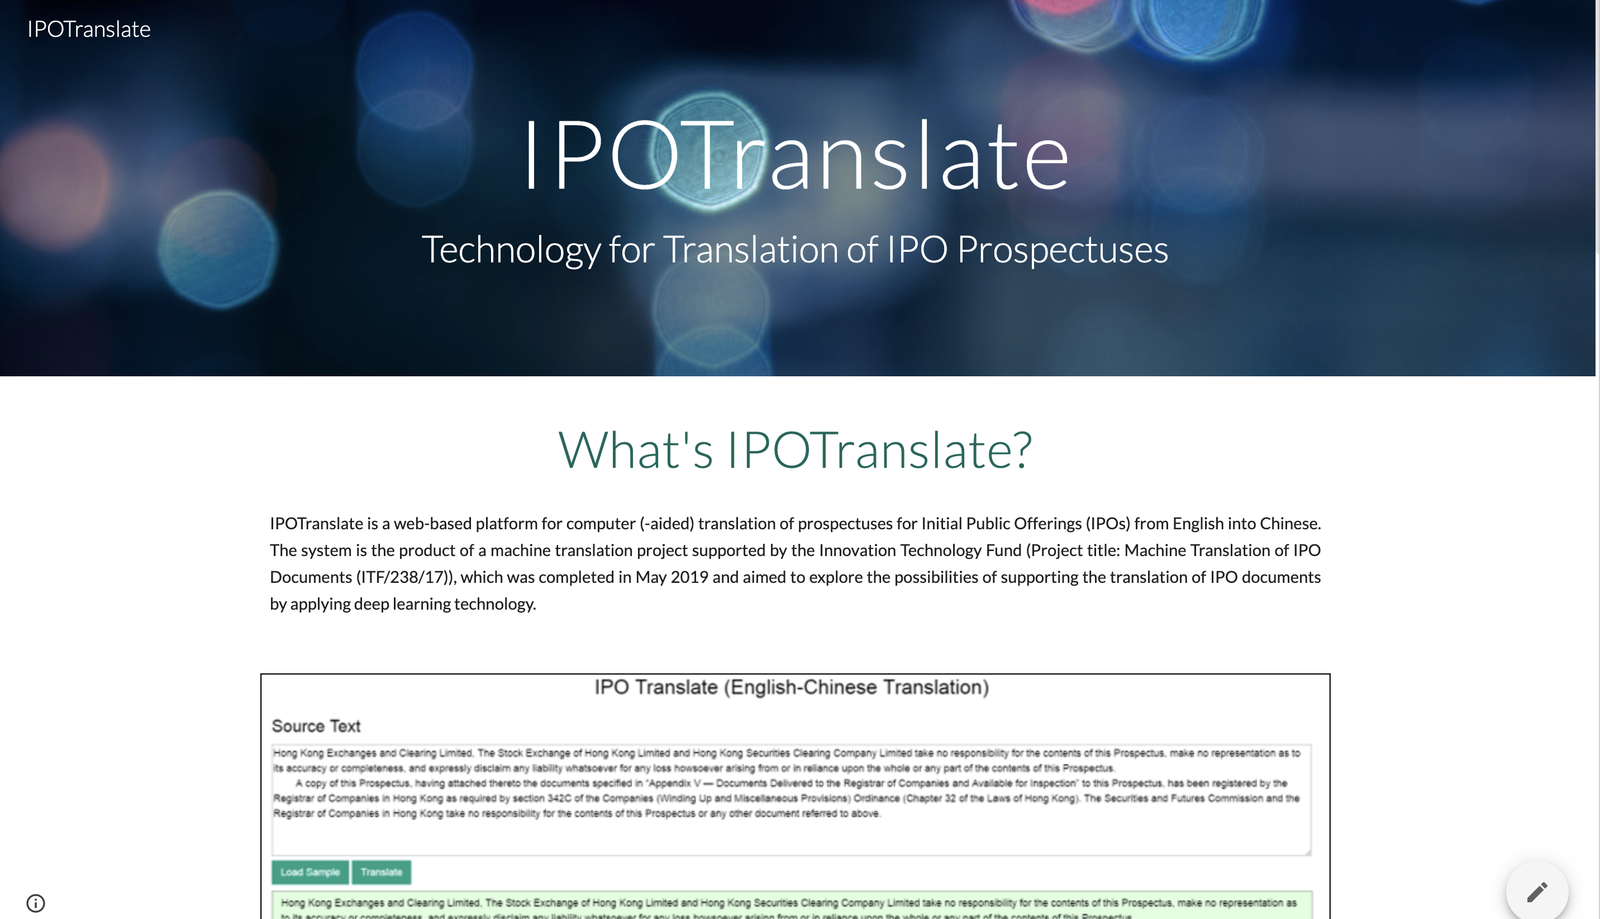

Slide 26
IPO Prospectuses in Hong Kong
IPO prospectus is a comprehensive document that outlines the details of a company's financial health, operations, and plans.
In Hong Kong, IPO prospectus must be available in both English and Chinese to cater to the diverse investor base and comply with regulatory requirements.
This has led to high demand for professional translation services to ensure accurate and timely translations.

Slide 27
Features of the platform
Feature 1: Specialized NMT models trained on financial documents
Feature 2: Two models with distinct architectures for generation of two results
1. Recurrent Neural Networks (RNN)
2. Self-attention Neural Networks (e.g., Transformer)
Bidirectional RNN with Attention
Multi-head Attention with Queries, Keys and Values

Slide 28
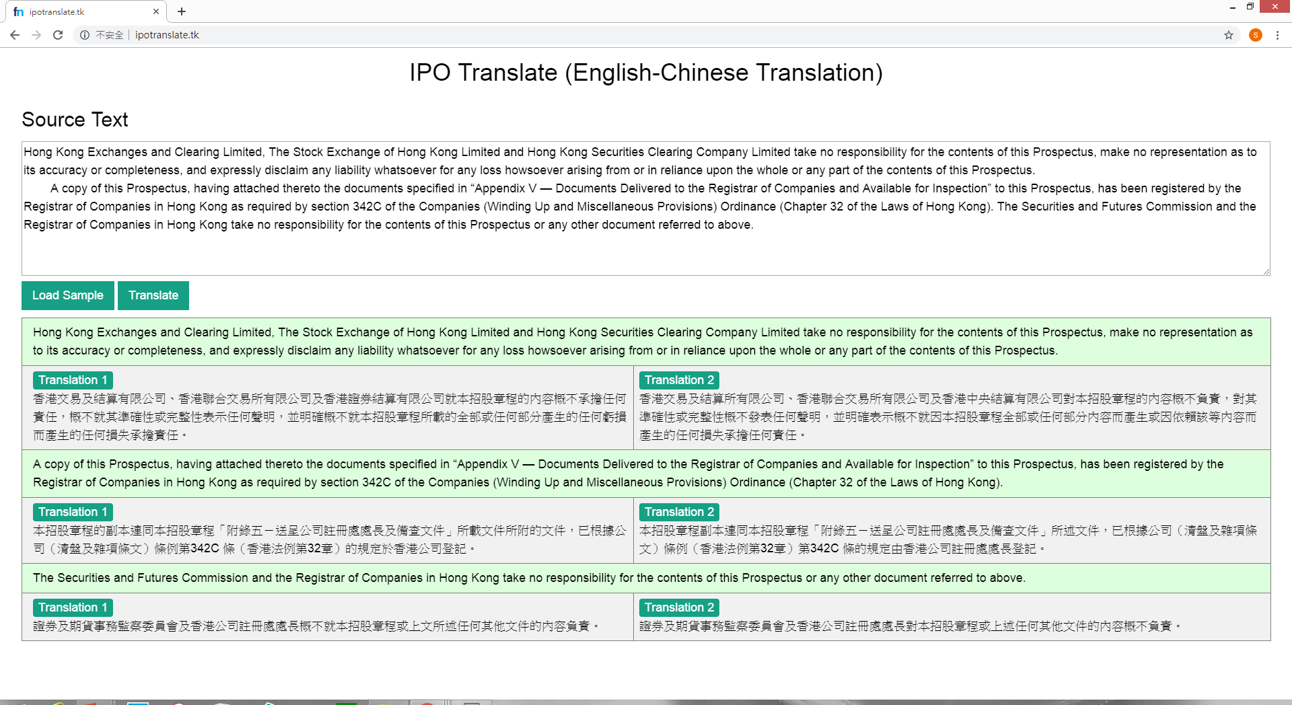

Slide 29
Example
Source Text：You should rely only on the information contained in this prospectus to make your investment decision.
Reference Translation：閣下應僅依賴本招股章程所載資料作出投資決定。
General MT：您應僅依賴本招股說明書中包含的信息來做出您的投資決定。
Our Model: 閣下應僅依賴本招股章程所載資料作出投資決定。

Slide 30
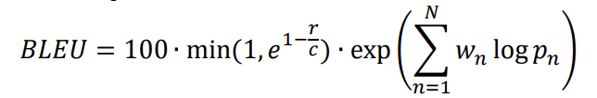
Experiment: results
 | Google | IPOTranslate Model 1 | IPOTranslate Model 2
BLEU Score | 36.89 | 44.48 | 53.73

Slide 31
Platform 2: GovPR Translation
An AI-driven platform for the translation of government press releases
The work was supported by a grant from the Research Grants Council of the Hong Kong Special Administrative Region, China (Project No. UGC/FDS14/H16/18).

Slide 32
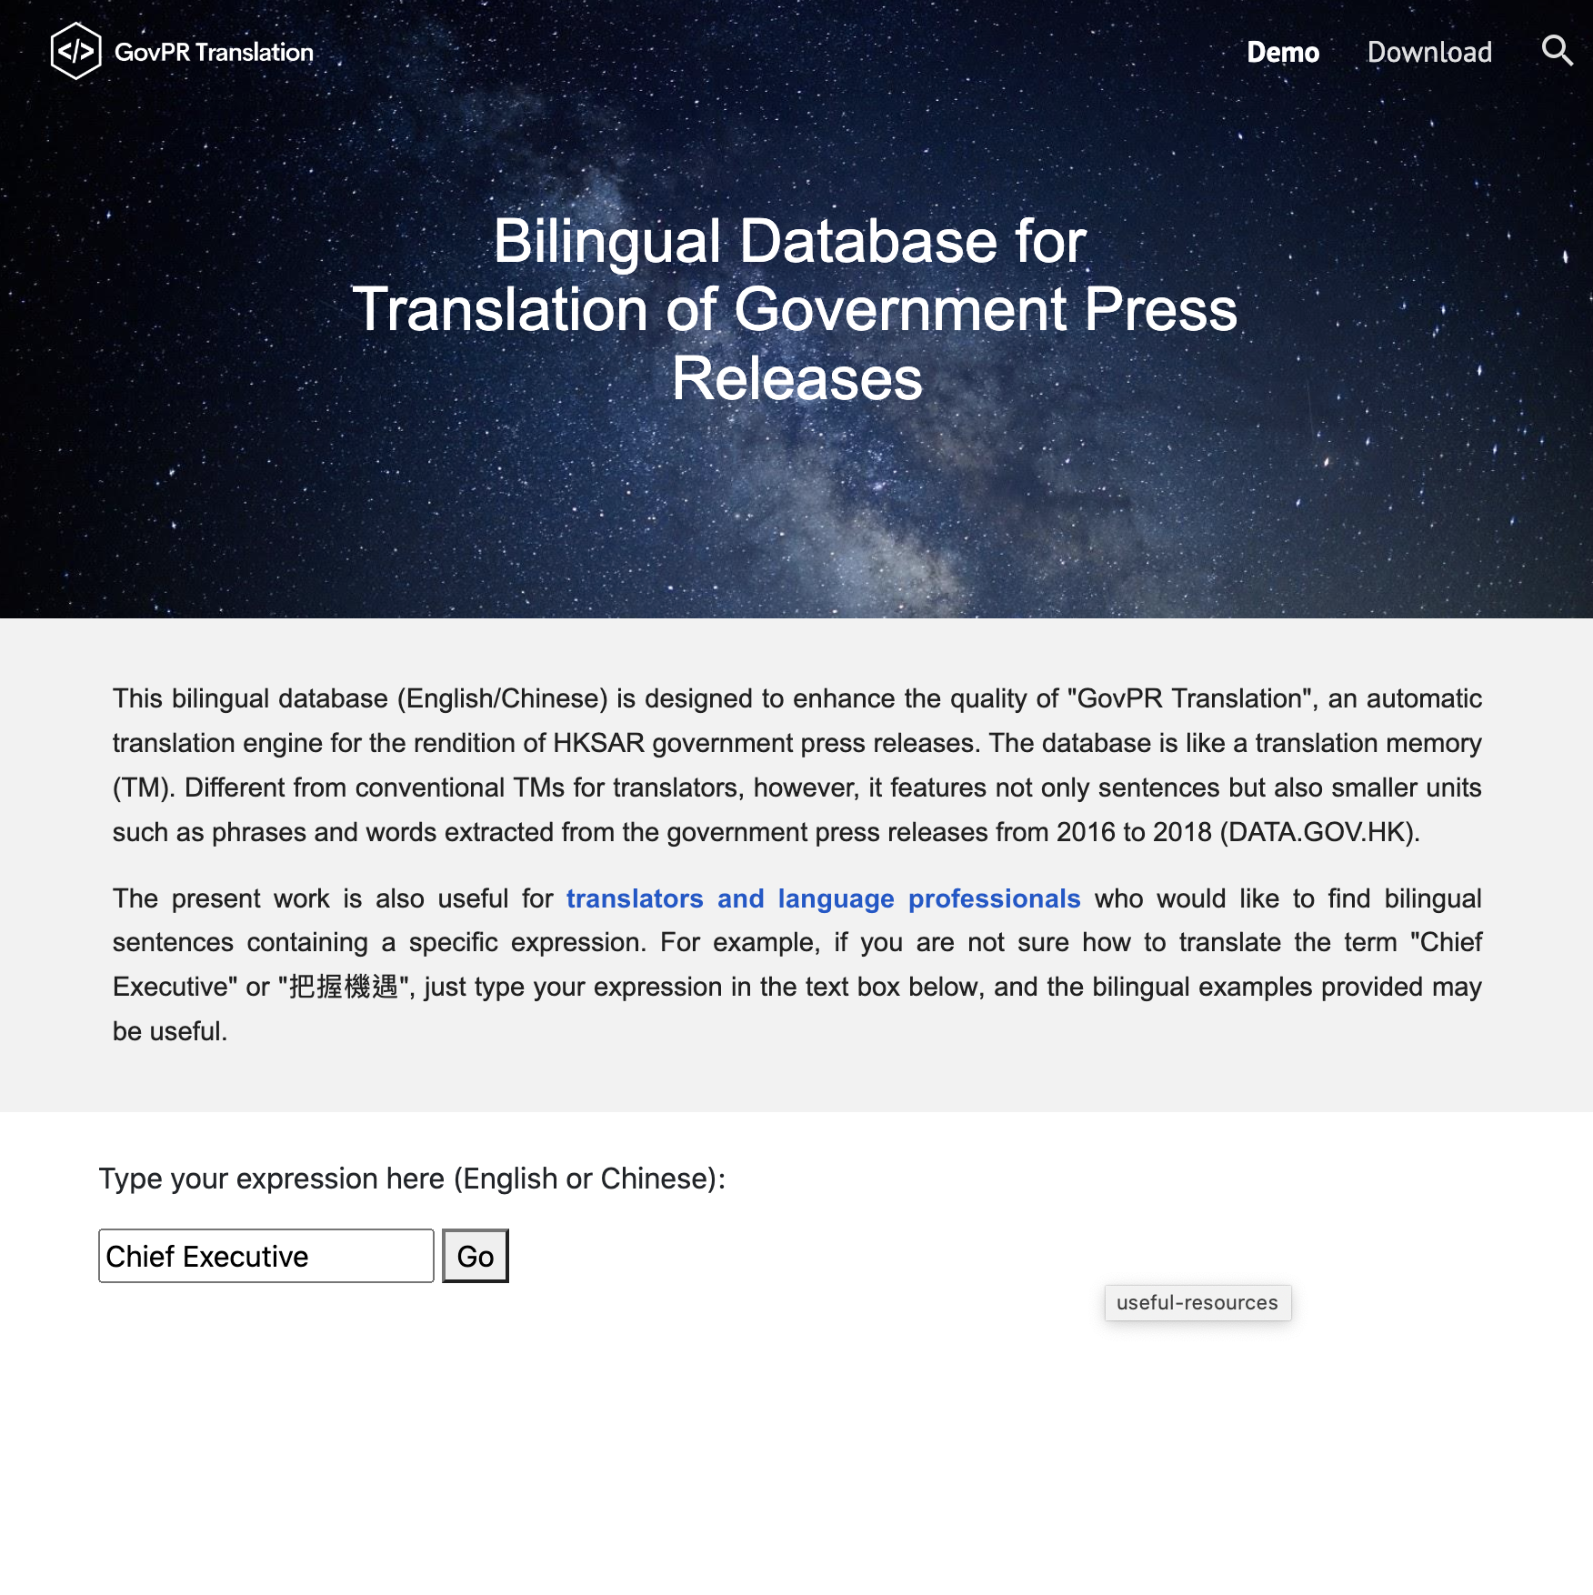
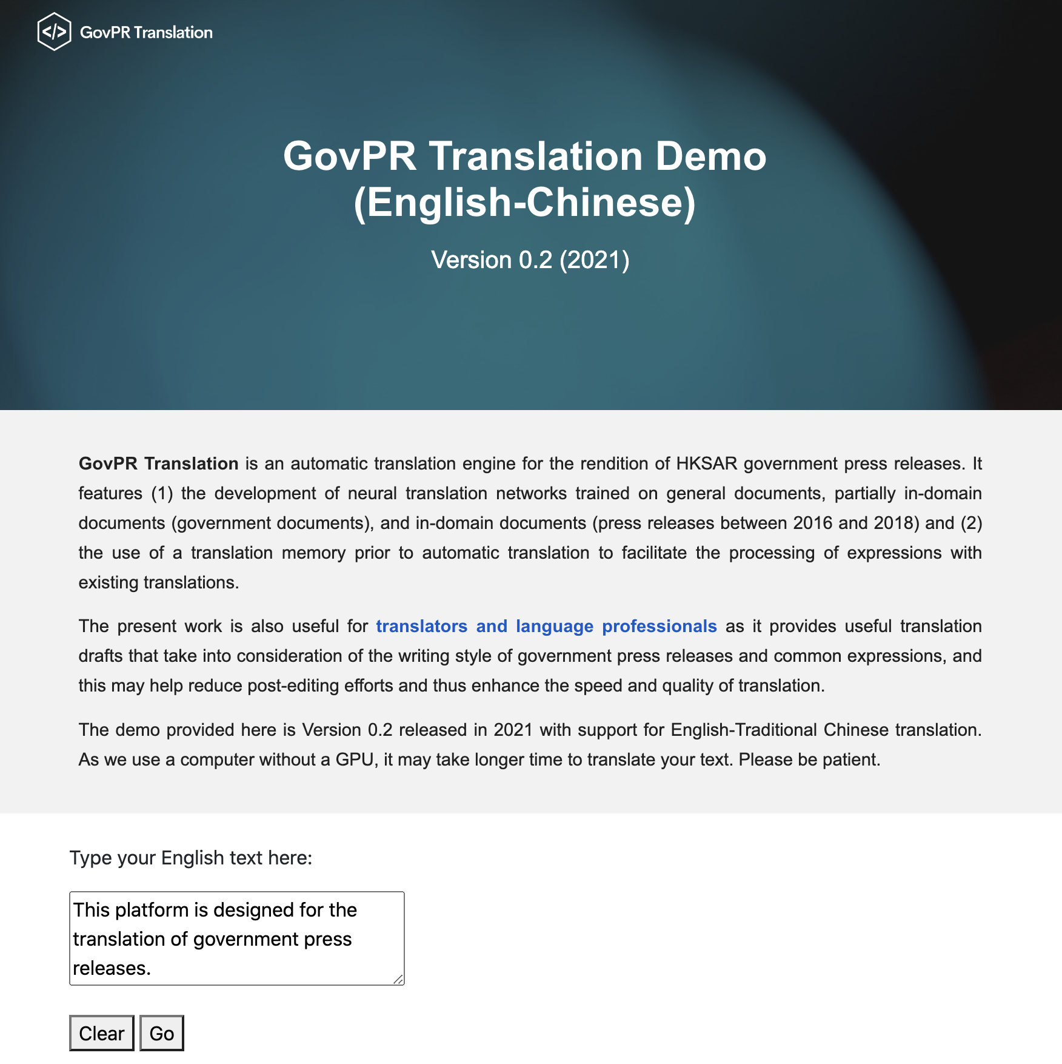
Our systems

Slide 33
Hong Kong Government Press Releases
An important communication channel between the government and the public
Information provided by different bureaus and departments
Example: https://www.info.gov.hk/gia/general/today.htm
Three versions: English, Traditional Chinese, and Simplified Chinese

Slide 34
Features of our approach
Feature 1: Development of NMT models trained on specialized data
Feature 2: Integration of Translation Memory (TM) and NMT

Slide 35

Two key stages
1. Pre-translation
2. Machine translation
NMT
ST
TT
General documents +
Government documents +
Government press releases
TM

Slide 36
Example (Siu 2022)
Source Text: The Leisure and Cultural Services Department (LCSD) will implement special opening hours at its performance venues and URBTIX outlets during the Lunar New Year holidays, an LCSD spokesman announced today (January 21). Details are as follows:
Official Reference Translation: 康樂及文化事務署（康文署）發言人今日（一月二十一日）宣布，農曆新年期間轄下各表演場地及城市售票網售票處的開放時間如下：
Output 1 (NMT): 康文署發言人今日(一月二十一日)宣布,康樂及文化事務署(康文署)將於農曆新年假期舉行特別開放時間及城市售票網,詳情如下:
Output 2 (GovPR Translation): 康文署發言人今日(一月二十一日)宣布,在農曆新年假期期間,其表演場地及城市售票網售票處會實施特別開放時間,詳情如下:

Slide 37
Experiment: results
 | BLEU score of model without pre-translation | BLEU score of model with pre-translation | BLEU difference after pre-translation
Google | 23.73 | 35.51 | +11.78
Our Work | 38.75 | 44.71 | +5.96

Slide 38
Platform 3: DharmaBridge
An AI-powered platform for translating modern Buddhist writings from Chinese into English
The work is part of an on-going project supported by a grant from the Research Matching Grant Scheme.

Slide 39
Buddhist Text Translation
When discussing Buddhist text translation, we often focus on translating ancient sutras into modern languages. Examples:
Sanskrit
Pali
Classical Chinese
Tibetan

Slide 40
Buddhist Translation in the Digital Age
We focus on modern Buddhist writings.
Explaining Buddhist teachings using modern language
Providing modern examples that illustrate how Buddhist principles can be practically applied in daily life

Slide 41
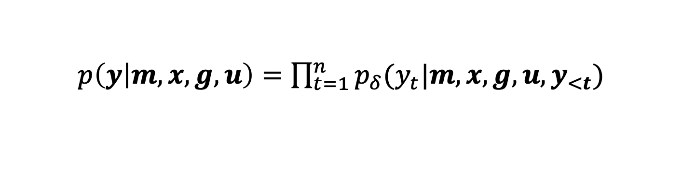
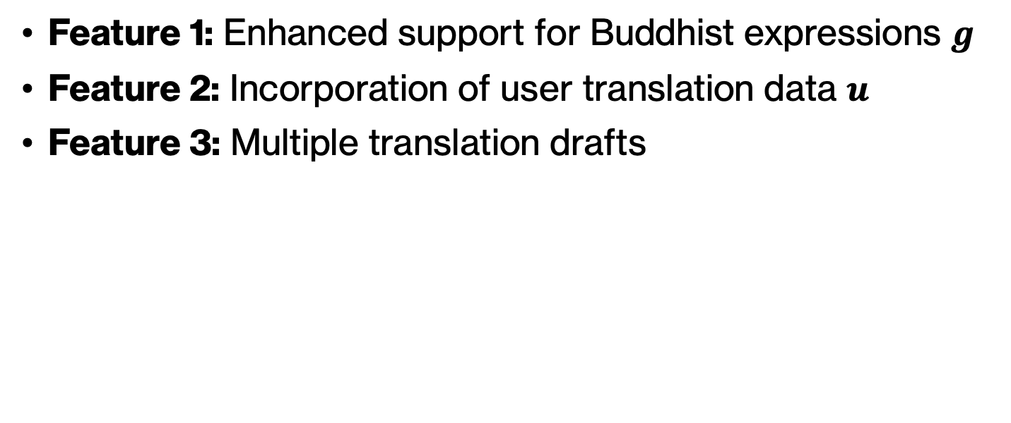
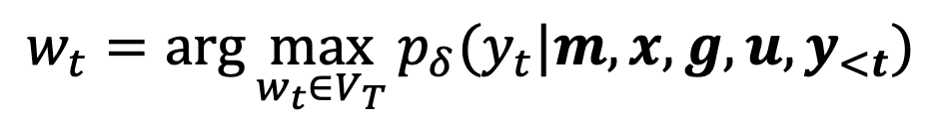
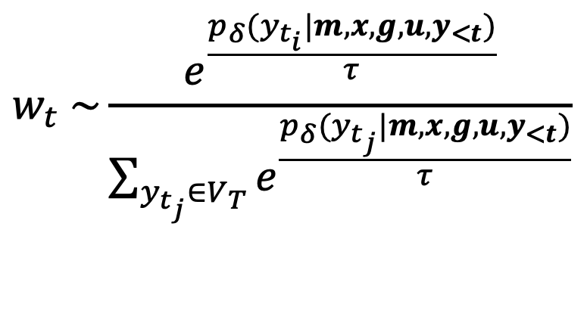
Features
Feature 1: Enhanced support for Buddhist expressions $g$
Feature 2: Incorporation of user translation data $u$
Feature 3: Multiple translation drafts
$p\left(y | m,x, g,u\right)=$ $\prod_{t=1}^{n}{p_{δ}(y_{t}|m,{x,g,u,y}_{<t})}$
$$w_{t} \sim \frac{e^{\frac{p_{δ}(y_{t_{i}}|m,{x,g,u,y}_{<t})}{τ}}}{\sum_{y_{t_{j}}∈V_{T}}{e^{\frac{p_{δ}(y_{t_{j}}|m,{x,g,u,y}_{<t})}{τ}}}}$$
$$w_{t}=\text{arg}\max_{w_{t}∈V_{T}}{p_{δ}(y_{t}|m,{x,g,u,y}_{<t})}$$

Slide 42
4. More Information

Slide 43
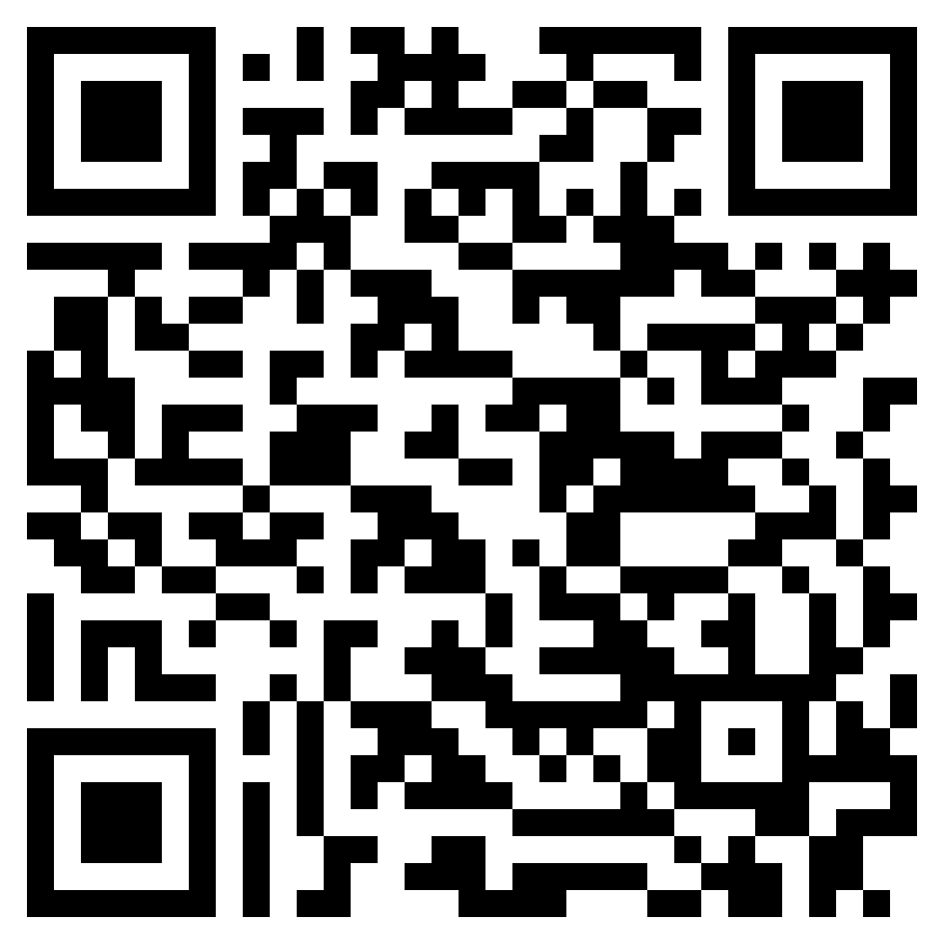
Read More
“ChatGPT and GPT-4 for Professional Translators: Exploring the Potential of Large Language Models in Translation” (Siu 2023a) [Link]
An Overview of ChatGPT and its Predecessors
ChatGPT as a Tool for Translators: Exploring Use Cases
Strengths and Limitations of ChatGPT in the Context of Translation
Impacts of ChatGPT on Translators and Language Professionals
The Future of ChatGPT as a Translation Tool

Slide 44
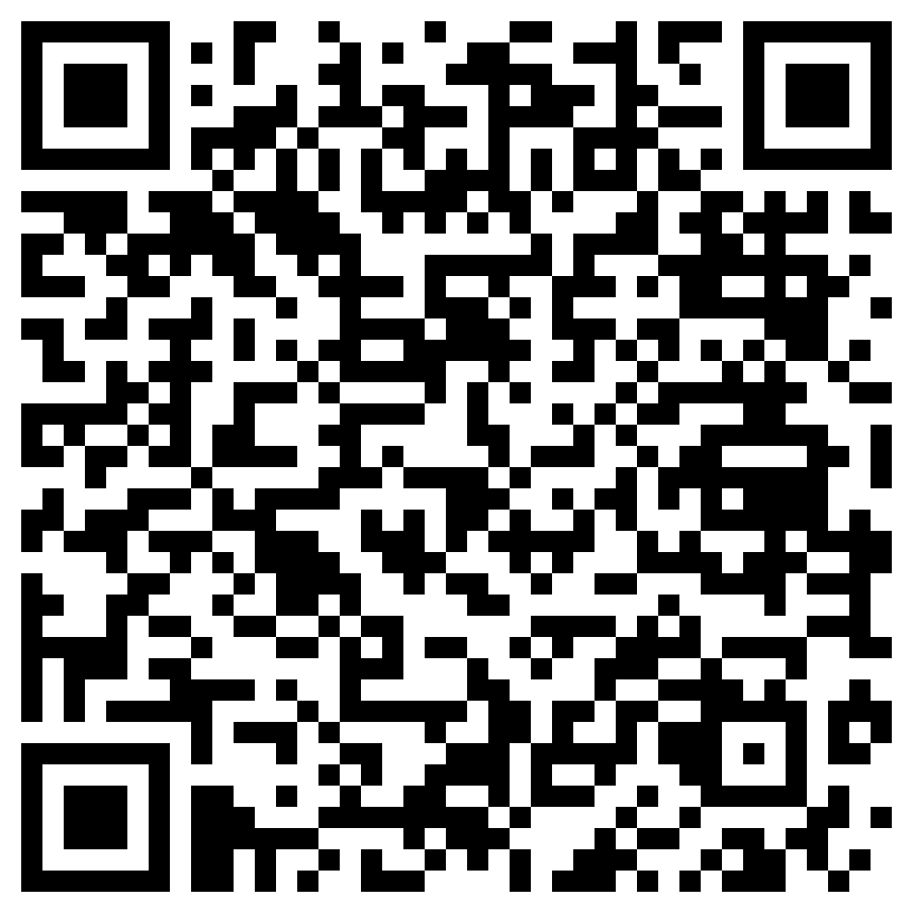
Read More
“Deep Learning and Translation Technology” - see Chapter 47, Routledge Encyclopedia of Translation Technology (2nd Edition) (Siu 2023b)
An Introduction to Deep Learning
Main Tasks of Deep Learning
An Overview of Neural Machine Translation
Recurrent Neural Networks for Translation
Convolutional Neural Networks for Translation
Self-attention Neural Networks for Translation
Deep Learning for Other Translation-related Applications
Other Noteworthy Trends

Slide 45
Read More
“Where Neural Machine Translation and Translation Memories Meet: Domain Adaptation for the Translation of the HKSAR Government Press Releases” – International Journal of Techno-humanities 1(1): 45-66 (Siu 2022)

Slide 46
Thank you!

